Slide 1

Mapping the Application Usability Level (AUL) Framework to the Technology Readiness Levels (TRLs) and other Readiness Levels
A.J. Halford, A. C. Kellerman, A. G. Burrell, J. Klenzing, B. A. Carter, K. Garcia-Sage, S. Elvidge, S. Bingham

Slide 2
Why use a framework to track progress?

Slide 3

It can help us build a bridge and navigate the valley of death

Slide 4



A tracking framework can ensure clear communication between developers/researchers and users about the use and current development stage of a product.

Slide 5
Which frameworks are out there? What were they designed to track?

Slide 6

Technology Readiness Levels, TRLs (Mankins 1995 https://ecss.nl/home/ecss-e-hb-11a-technology-readiness-level-trl-guidelines-1-march-2017/)
System Test, Launch, and Operations
TRL 9
TRL 8
TRL 7
TRL 6
TRL 5
TRL 4
TRL 3
TRL 2
TRL 1
System/Subsystem Development
Technology Demonstration
Technology Development
Research to Prove Feasibility
Basic Technology Research
Modified from NASA

Slide 7
Technology Readiness Levels
A method to estimate the maturity of technology for space flight
Supports efforts for risk management
Can help at proposal/mission formulation
Can help determine funding
Does not require an identified user or to define user requirements

Slide 8

Application Readiness Levels: ARLs (Lawrence Friedl/ NASA)
ARL 9
–
ARL 8
–
ARL 7
–
ARL 6
–
ARL 5
–
ARL 4
–
ARL 3
–
ARL 2
–
ARL 1
Partner Demonstration and Transition
Development, Test, and Validation
Discovery and Feasibility

Slide 9
Application Readiness Levels
Communication Tool: convey progress of the project towards sustained use.
Analysis Tool : assess progress of a project towards completion.
Reporting Tool: convey performance goals and completion of goals to funding agencies.
Diagnostic Tool : identify roadblocks in development.

Slide 10
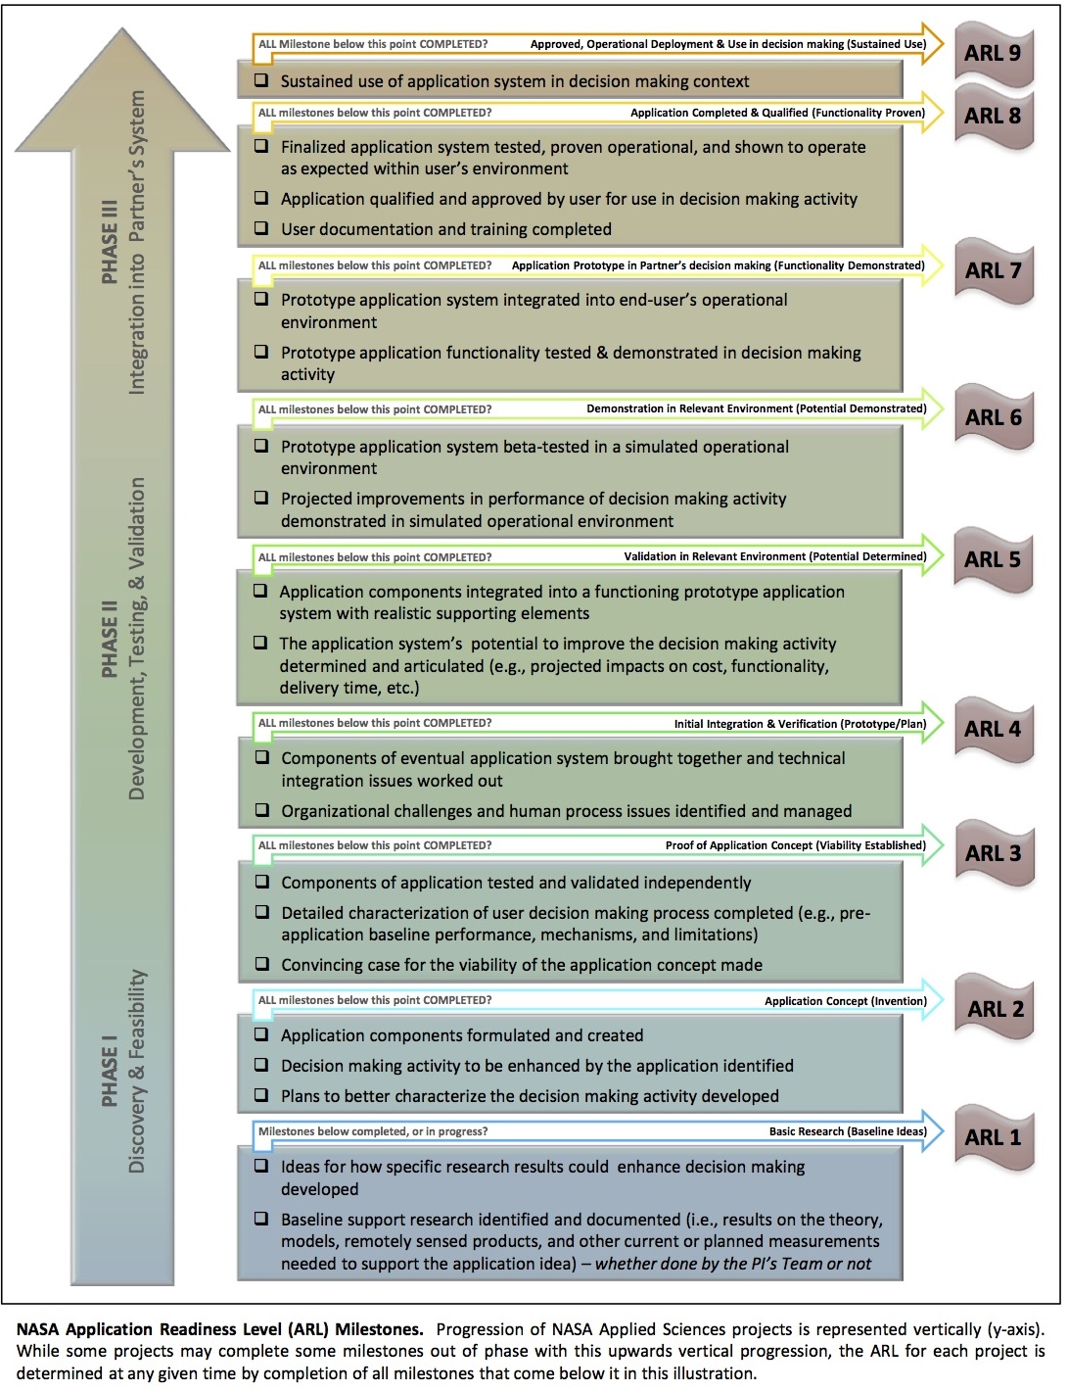
Application Readiness Levels
Each level has clear milestones which must be met for an application to advance to the next level.
During a grant cycle, teams are asked to state what the current ARL of the application is, what the goal ARL is, and to update these numbers each fiscal year.
It is not expected that a project will advance from ARL 1 to ARL 9 during one grant cycle (3 – 5 years).

Slide 11
Application Usability Levels (AULs) (Halford et al 2019)
Development, Testing, and Validation
Discovery and Viability
AUL 1 AUL 2 AUL 3
AUL 4 AUL 5 AUL 6
AUL 7 AUL 8 AUL 9
Implementation and integration into operational status

Slide 12
Barrier for effective applied space weather: (from the research side)
Finding and knowing best how to communicate with end users
Knowing what research will produce useful tools to aid decision making processes.
Knowing the requirements and needs of the user community
Advertising how our research could be useful
Application Usability Levels

Slide 13
Application Usability Levels
Communication Tool: convey progress of an agreed upon project/product with an identified user towards sustained use.
Analysis Tool : assess progress of a project towards usability and meeting of the users agreed upon requirements.
Reporting Tool: convey user requirements and metrics as well as operational environment
Diagnostic Tool : identify roadblocks in development. Can also be used to identify new applications and new users

Slide 14
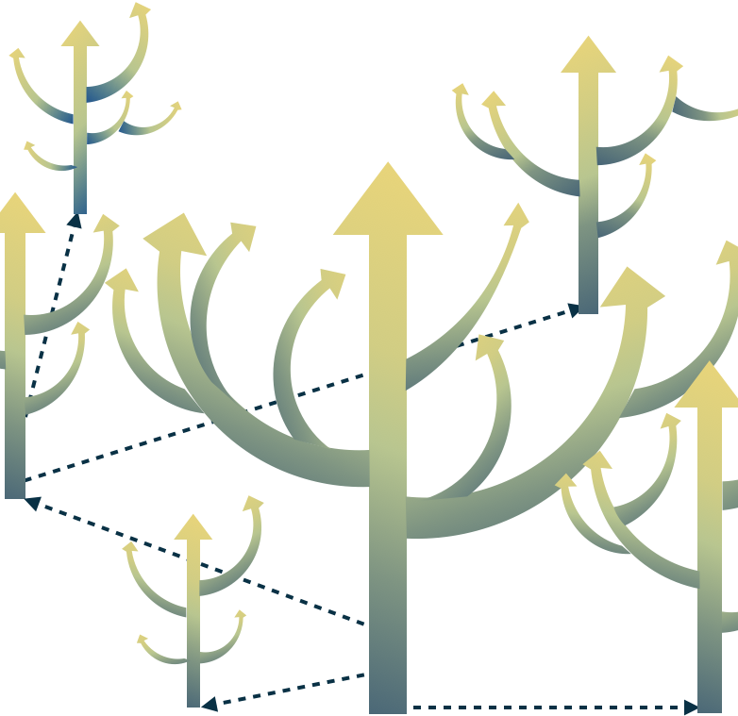
Application Usability Levels
Each level has clear milestones which must be met for an application to advance to the next level. Both the user and researcher must agree that the level has been attained.
The AULs allow for progress to be shown without necessarily completing science closure.
If the user requirements change, then a new branch is generated. This allows for continued development with the original requirements and clear reporting on the new product AUL path.

Slide 15
Mapping between the frameworks

Slide 16
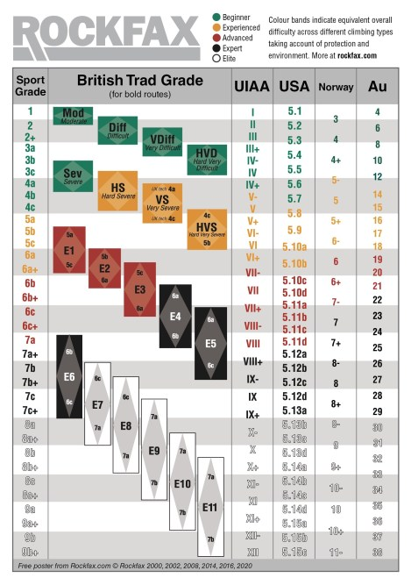
When comparing different frameworks we can look to how others have done this. Here is an example for international scales of rock climbing.
https://rockfax.com/climbing-guides/grades/

Slide 17
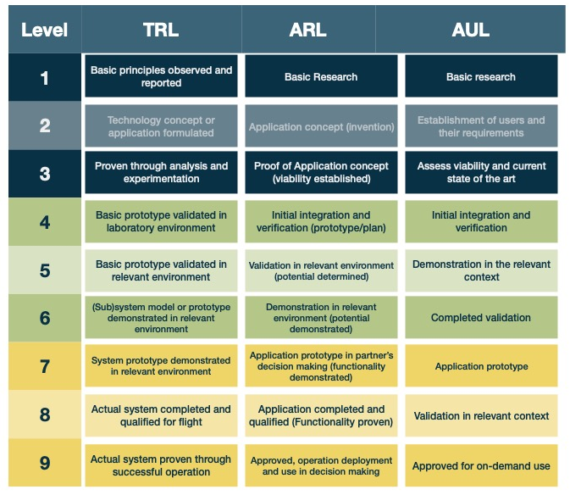
We can attempt to do a similar mapping – however there are areas without one-to- one correlation.
For example, no user is identified in the TRLs. The ARLs and AULs do not require operation in the space environment.

Slide 18
Pick the right framework: Where there is overlap and where they differ

Slide 19
What is each frameworks motivation?
What is the framework tracking towards?

Slide 20
Technology Readiness Levels:
Will this tool, be it software or hardware, work in the space environment?

Slide 21
Application Readiness Levels:
Will this tool, be it software or hardware, work in the user specified environment and aid in a decision-making context.

Slide 22
Application Usability Levels:
Will the output of this project, be it software, hardware, data, or something else be able to provide a specific use and aid the identified user.

Slide 23
The AULs transform the monolog of the TRLs and ARLs of the researcher/engineer about their projects progress, into a dialog with the user ensuring the products usability and want for the product upon completion

Slide 24

The AULs provide a framework for a continuing dialog. This consistent conversation ensures that from the start all parties are aware of the expected use, requirements, metrics, and user guides and validation techniques as well as the reporting and documentation of progress.

Slide 25
Each framework can ensure clear communication between developers/researchers and users about the use and current development stage of a product.
If flying in space is the goal –use TRLs
If ensuring readiness for use in industry – use ARLs
If ensuring usability by someone else – use AULs

